Slide 1
Introduction to Verilog

Slide 2
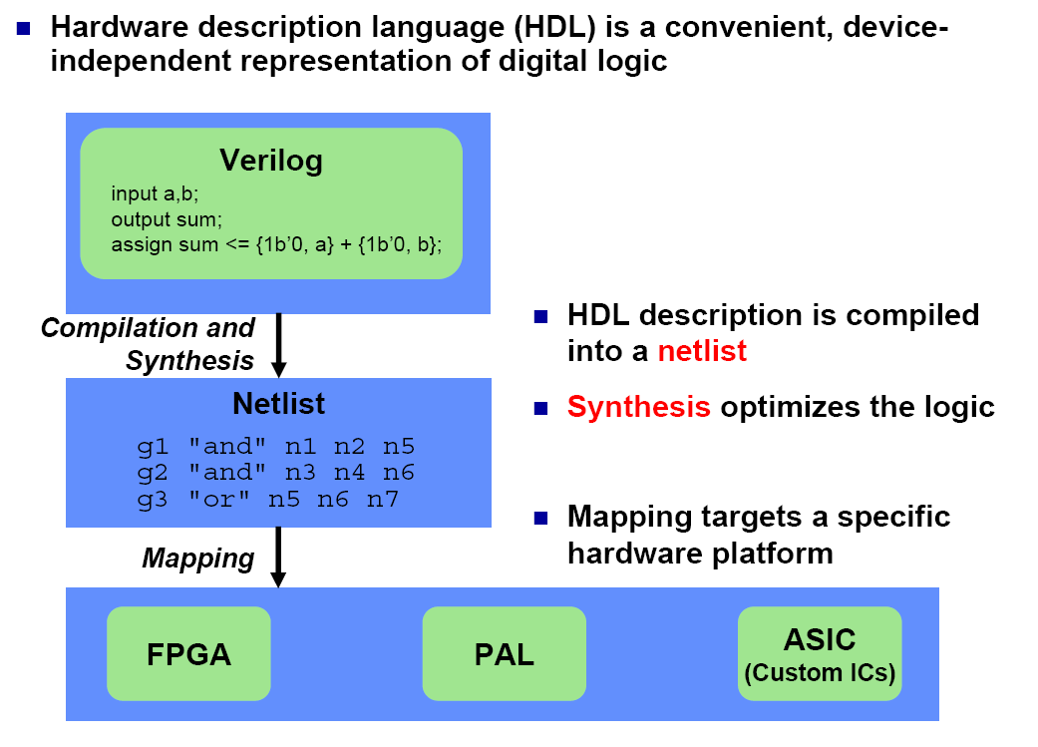
Synthesis and HDLs

Slide 3
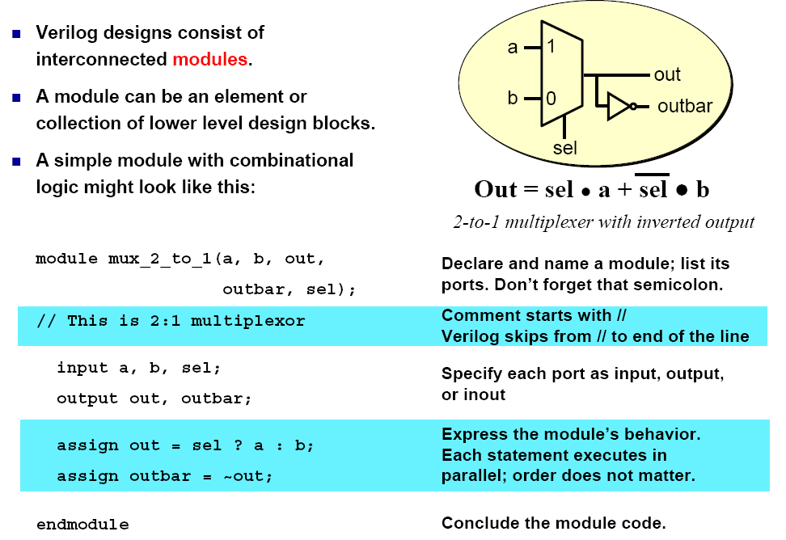
Verilog: The Module

Slide 4
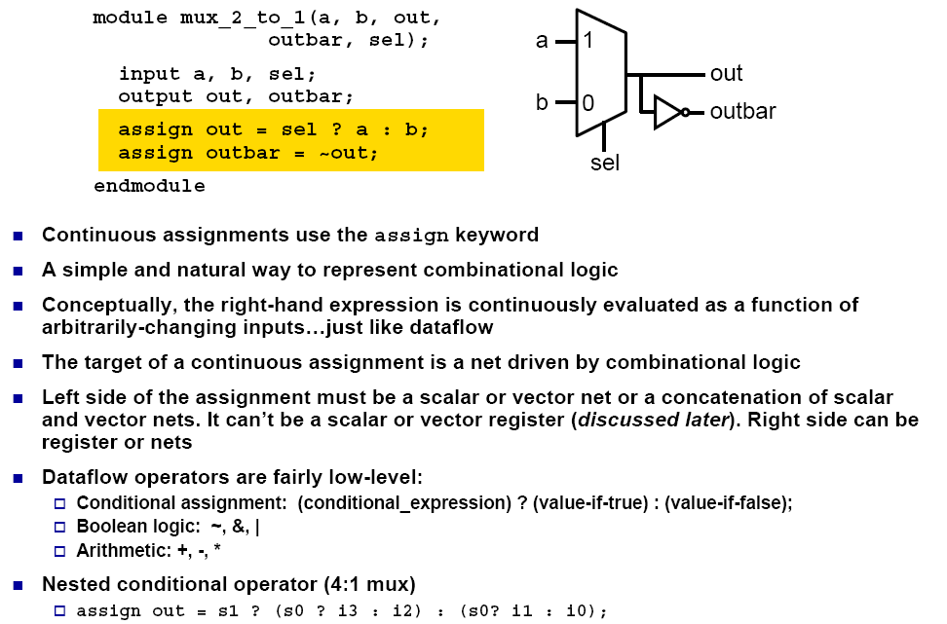
Continuous (Dataflow) Assignment

Slide 5
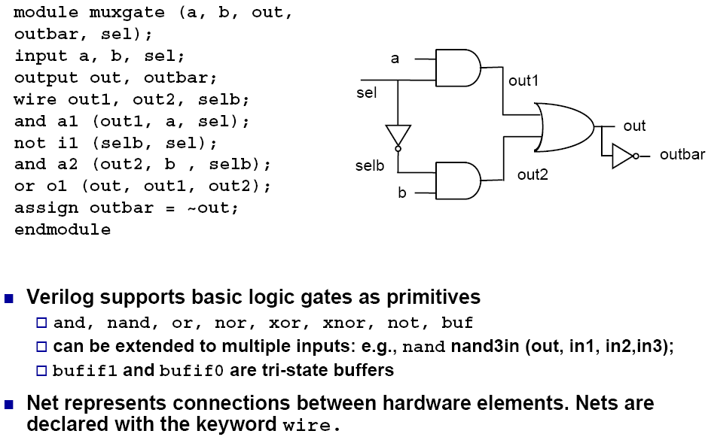
Gate Level Description

Slide 6
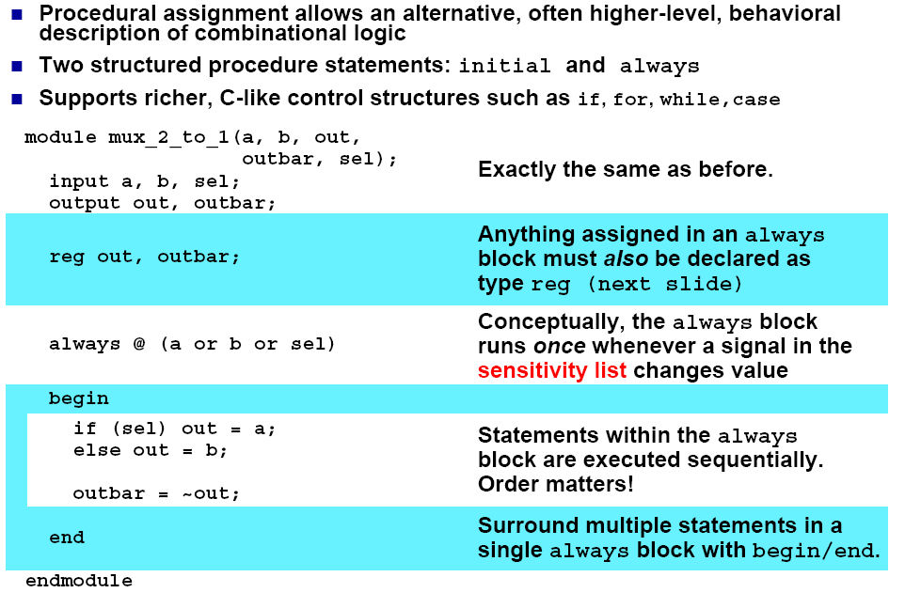
Procedural Assignment with always

Slide 7
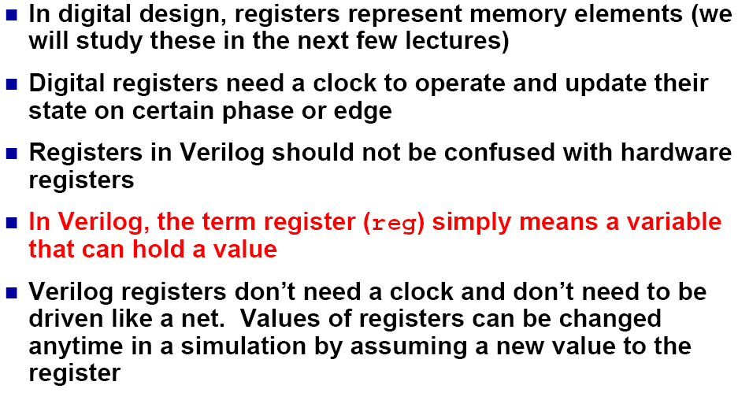
Verilog Registers

Slide 8
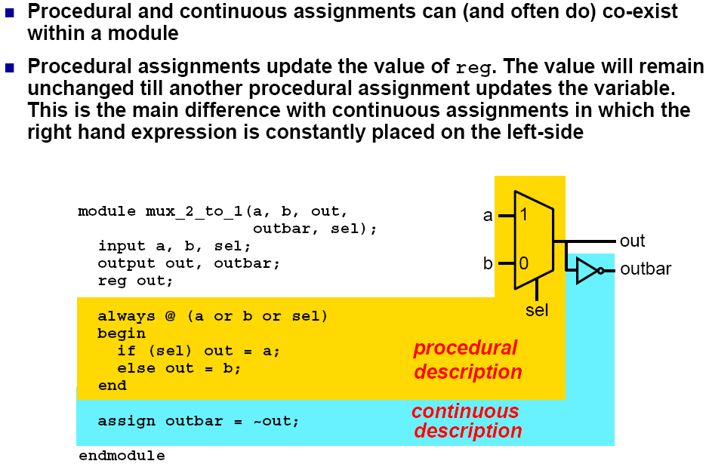
Mix-and-Match Assignments

Slide 9
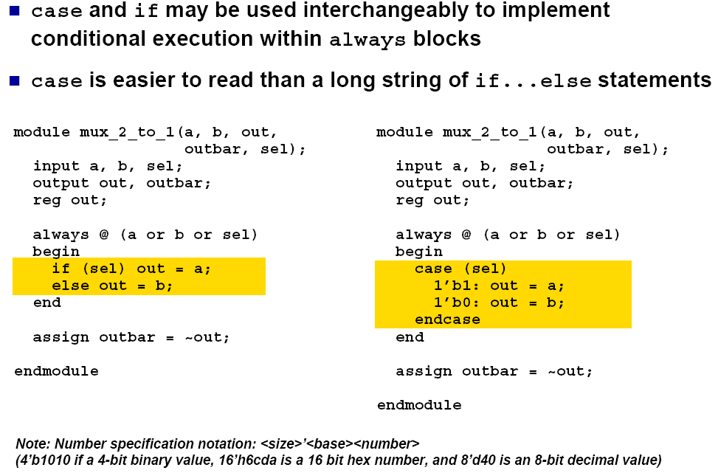
The case Statement

Slide 10
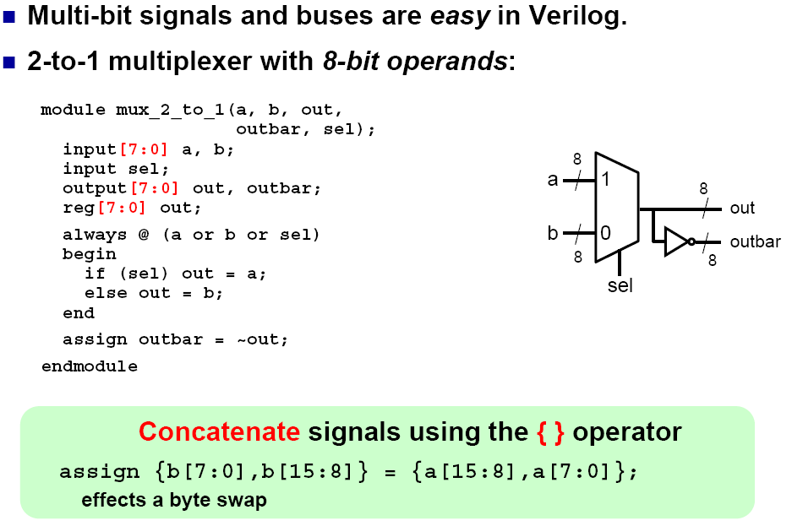
The Power of Verilog: n-bit Signals

Slide 11
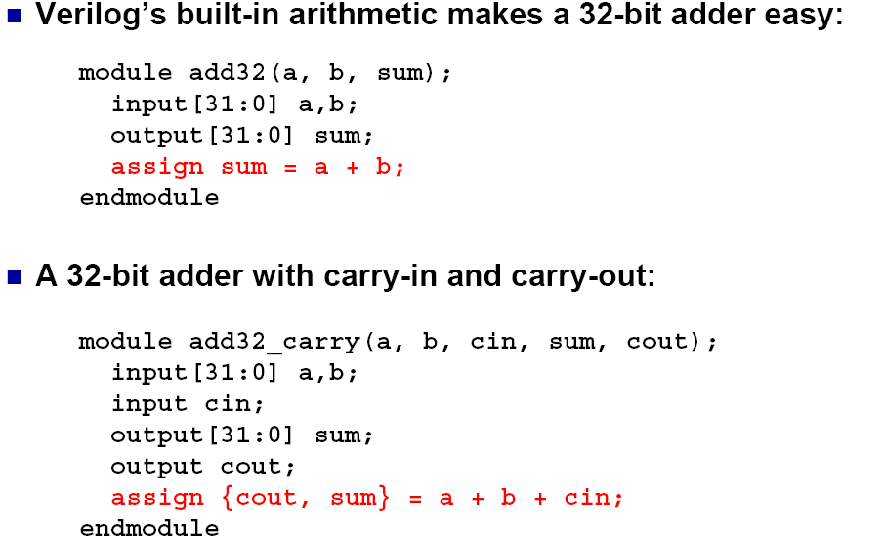
The Power of Verilog: Integer Arithmetic

Slide 12
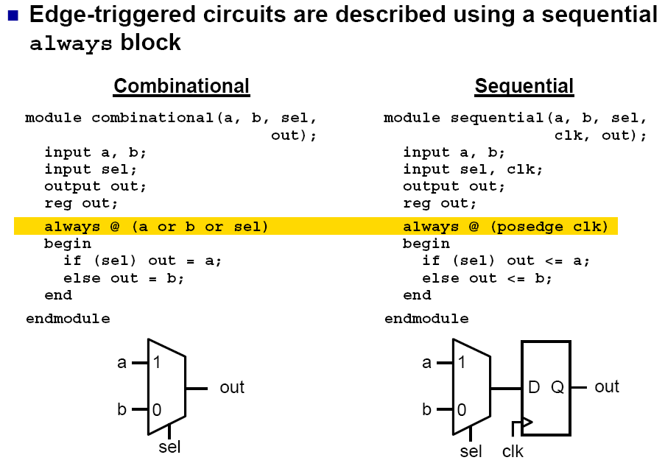
The Sequential always Block

Slide 13
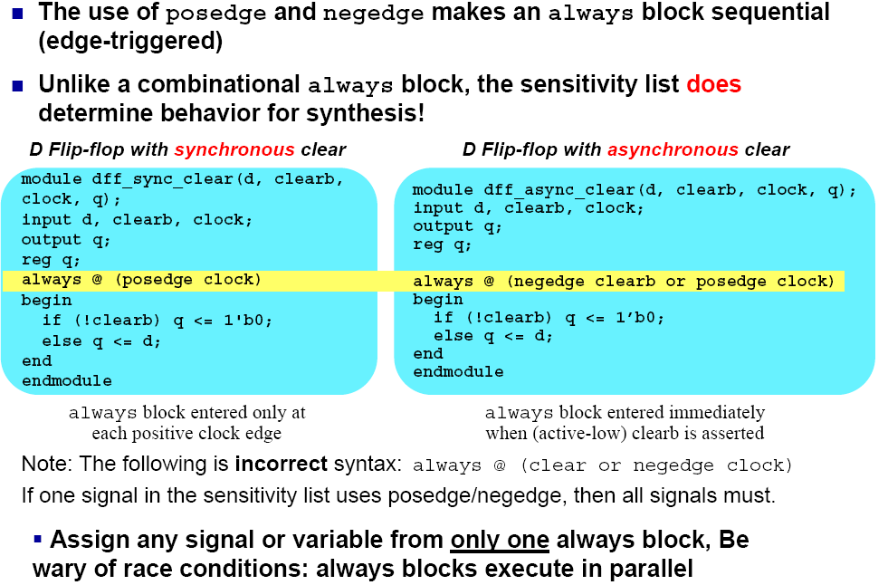
Importance of the Sensitivity List

Slide 14
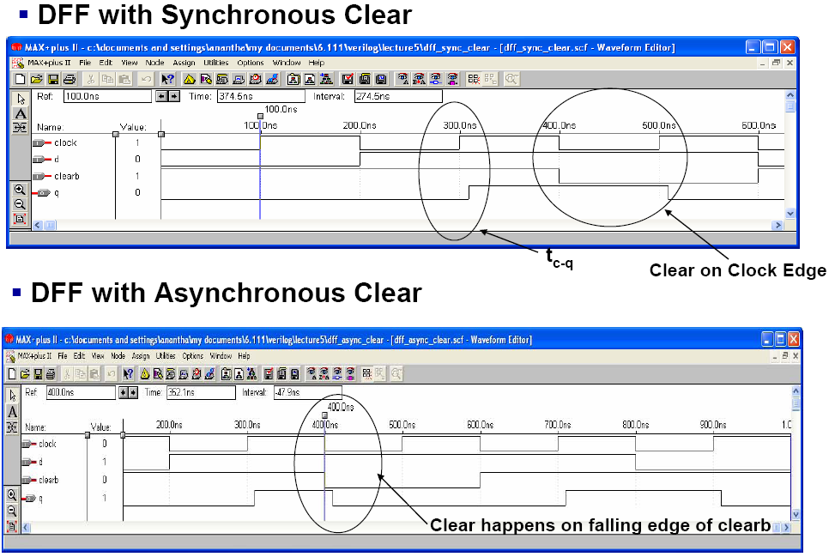
Simulation

Slide 15
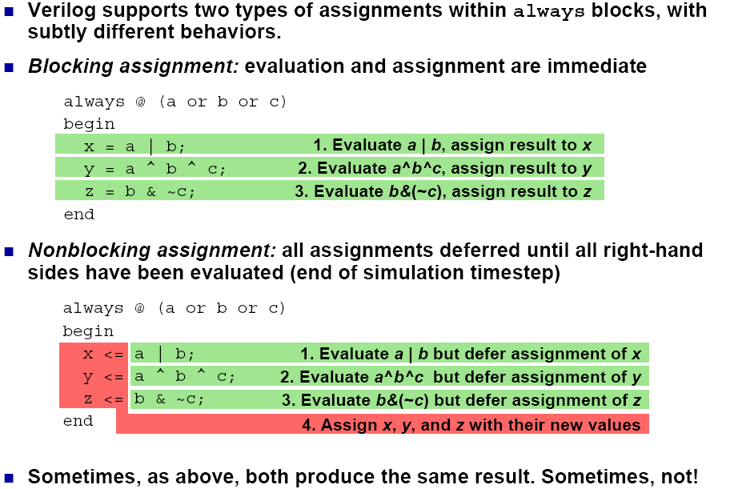
Blocking vs. Nonblocking Assignments

Slide 16
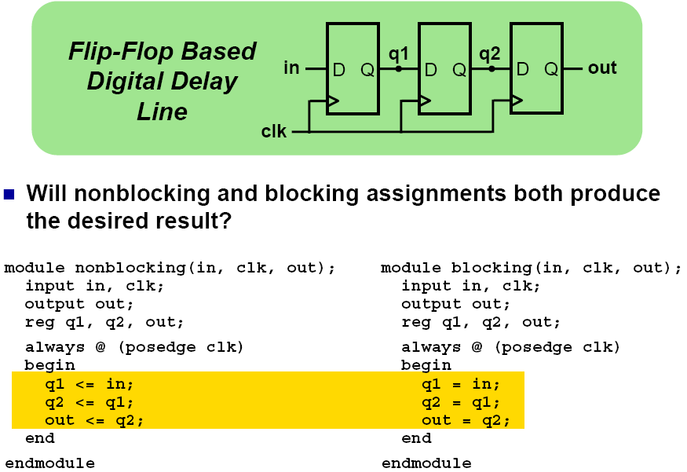
Assignment Styles for Sequential Logic

Slide 17
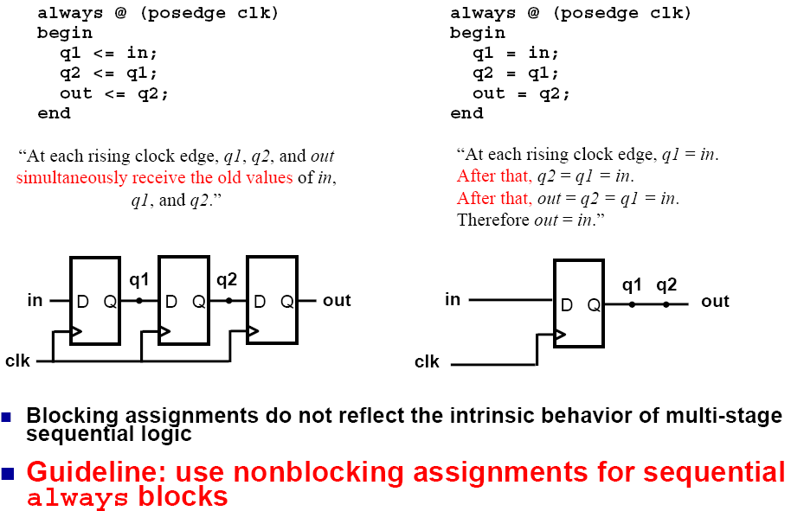
Use Nonblocking for Sequential Logic

Slide 18
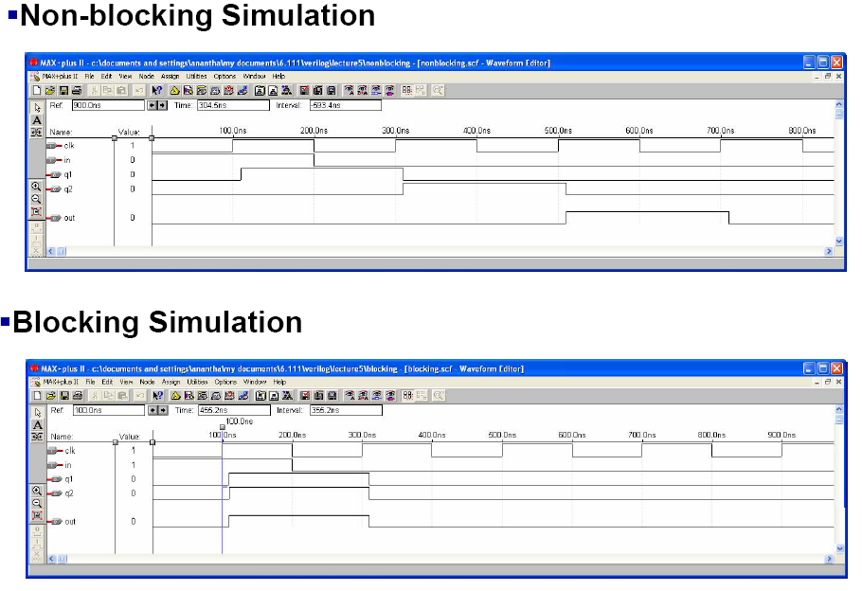
Simulation

Slide 19
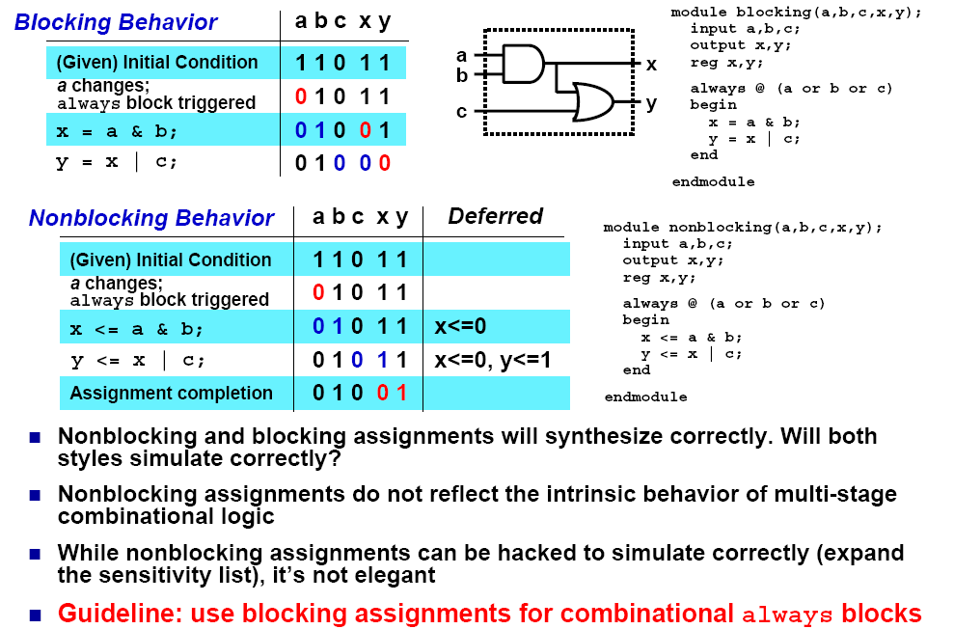
Use Blocking for Combinational Logic

Slide 20
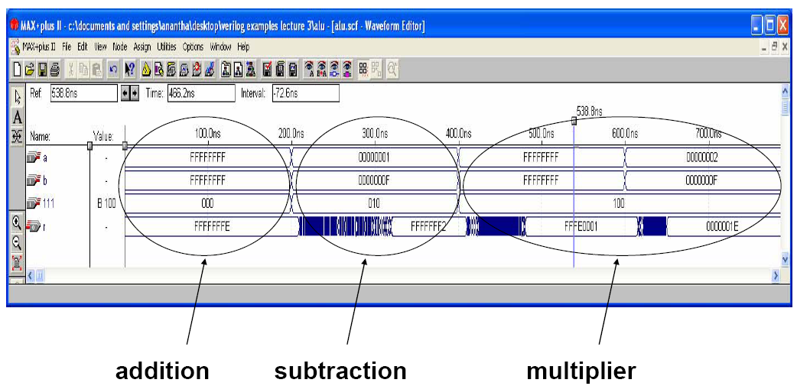
Simulation

Slide 21
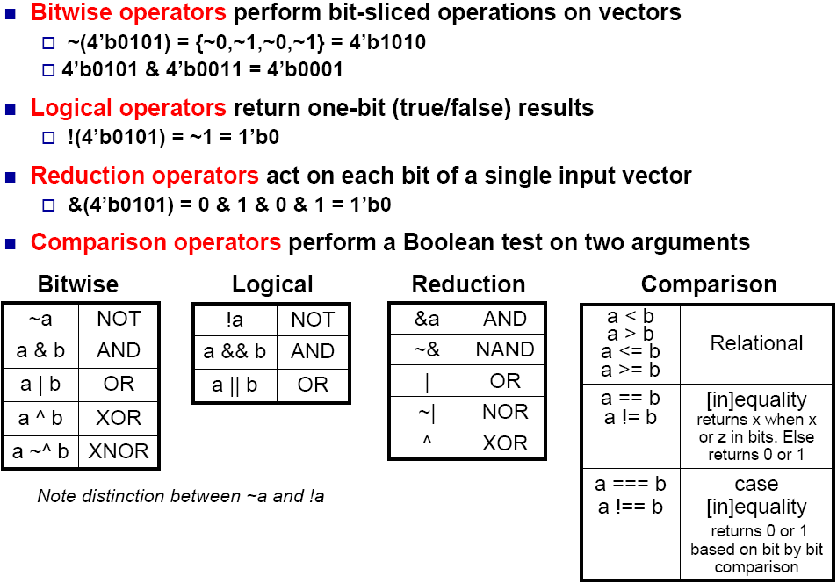
Useful Boolean Operators

